Slide 1

COUNCIL FOR TECHNICAL EDUCATION AND VOCATIONAL TRAINING (CTEVT) DEPARTMENT OF COMPUTER ENGINEERING Acme College Of Engineering Bagdol-04, Lalitpur
STUDENT MANAGEMENT SYSTEM
Presented by:
Amit Neupane
Avinish Kumar Singh
Gopal Khadka
Sagar Kushwaha
Sumit Pratap Sah
Presented to :
Department of Computer Engineering

Slide 2
1. INTRODUCTION
The traditional student management process can be complex and time-consuming; a Django-based Student Management System is proposed to streamline and automate these tasks.
The system includes features for managing students, staff, courses, attendance, results, and feedback.
This system improves efficiency, reduces errors, and provides a user-friendly interface for admins, staff, and students to manage academic activities.

Slide 3
2. PROBLEM STATEMENTS
Manually managing student and staff data, attendance, results, and feedback is time-consuming and prone to errors.
This process often leads to inefficiencies, delays, and difficulties in tracking individual performance and progress.
Maintaining accurate records and handling requests like leave applications can be cumbersome.

Slide 4
3. OBJECTIVES
Develop a Django-based Student Management System to streamline the management of students, staff, attendance, and academic records.
Automate attendance tracking and management of student and staff data
Create user-friendly interface for admins, staff, and students to easily interact with the system

Slide 5
4. SCOPE AND APPLICATIONS
The system can be used by schools, colleges, and universities to manage student information, attendance, and academic performance.
It can be adapted for administrative functions, such as leave management, feedback collection, and staff performance tracking.

Slide 6
5. EXISTING SYSTEM
In a traditional student management system, student information, attendance, and grades are often tracked manually through paper records.
Attendance is recorded by hand or through ID cards, and academic records are maintained in databases that require frequent updates.
This process is time-consuming, prone to errors, and requires substantial administrative effort to keep records accurate and up-to-date.

Slide 7
6. PROPOSED SYSTEM
The proposed system is a Django-based Student Management System that automates the management of student data, attendance, and academic records.
Instead of manual data entry, attendance and performance will be tracked through an integrated platform, allowing staff to easily update and monitor student records.
This automated approach reduces administrative workload, minimizes errors, and ensures more accurate, real-time data management.

Slide 8
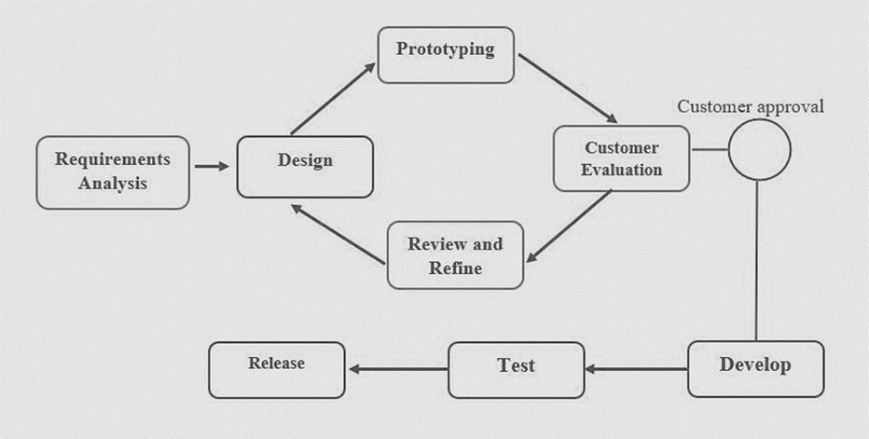
7. METHODOLOGY: Process Model
Figure 5.1: Prototype Model

Slide 9
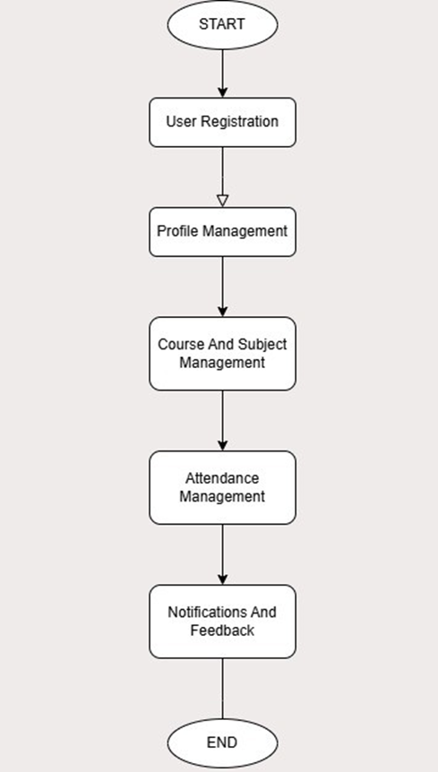
8. FLOWCHART
Figure 8.1: Flowchart

Slide 10
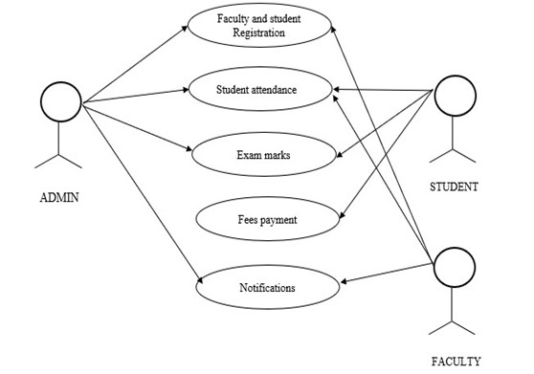
9. UML DIAGRAMS
9.1. USE CASE DIAGRAM
Fig.9.1 Use Case diagram

Slide 11
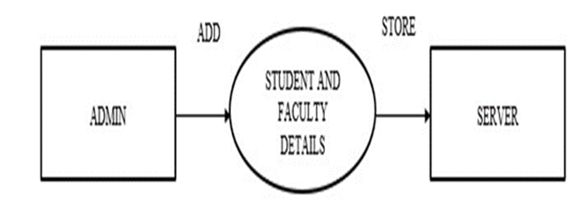
9.2. DFD Diagrams
9.2.1 Level-0 DFD
Fig 9.2.1: Level-0 DFD

Slide 12
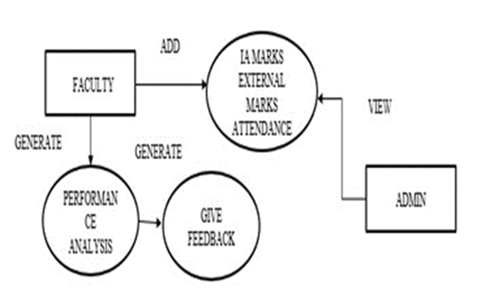
9.2.2 Level-1 DFD
Fig.9.2.2: Level-1 DFD

Slide 13
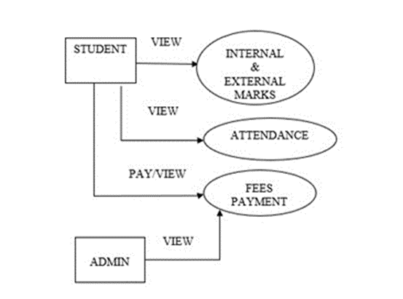
9.2.3 Level-2 DFD
Fig 9.2.3: Level-2 DFD

Slide 14
10. TOOLS USED
PYTHON
DJANGO
HTML/CSS
VSCODE
BOOTSTRAP
SQLITE

Slide 15
11. RESULTS AND CONCLUSIONS
The system will streamline administrative tasks, reducing time and effort needed for managing attendance, student data, and academic records.
It will eliminate paperwork, improve accuracy, and ensure real-time data management for both students and staff.
The automation will enhance efficiency, reduce errors, and provide a user-friendly experience for all users involved.

Slide 16
12. FUTURE ENHANCEMENT
The future enhancement of the system can be done by introducing online examination module to conduct online examination.
Further, the faculty can upload subject notes and videos of their class lectures on this site and students who has missed those classes can view those videos.

Slide 17
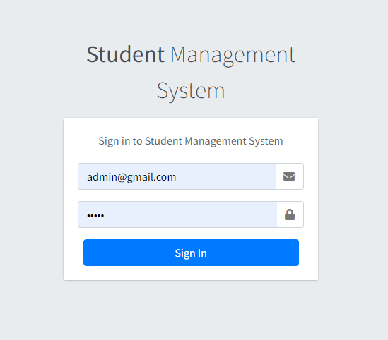
13. SCREENSHOTS

Slide 18
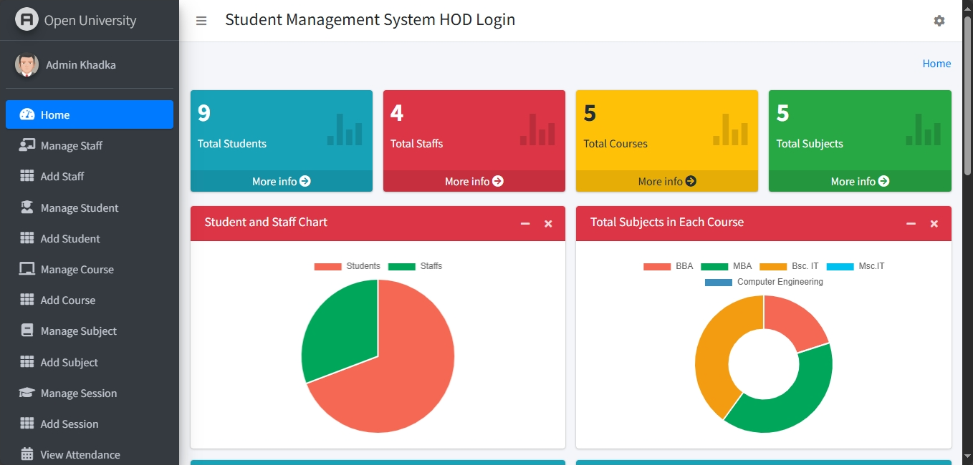

Slide 19
Thank you

